Slide 1

Feature Extraction Using Deep Convolutional Neural Networks For Offline Signature Verification
Biometric Systems Project
Manoochehr Joodi Bigdello – 1860273
Ziba Khani – 1799920
Prof. Maria De Marsico
June 2020

Slide 2
Why Signatures?
Authorization of individuals are becoming more essential tasks in:
e-commerce
forensic science
engineering
border control
access control
travel and immigration,
Healthcare
…
Traditional authentication methods are less reliable because of loss, forgetfulness, and theft, because they are based on:
knowledge (password-based authentication)
or the utility of a token (photo ID cards, magnetic stripe cards, and key-based authentication)

Slide 3
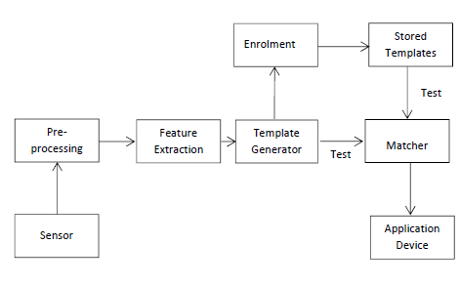
Introduction to Authentication systems
Authentication system is a system that provides:
Process to identify and verify the user's identity
Authenticate users using dynamic features of them
Figure 2. A Generic Authentication System with Computer Vision Technology[3]

Slide 4
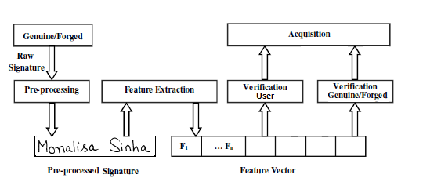
Signature as Images to process
Handwritten signatures → offline verification system
Our goal is to tackle the problem in the presence of skilled forgeries
We implemented CNN model in Keras to extract some features to distinguish:
two different users' signature
genuine or a forged signature
Figure 3. Block Diagram of our Automatic Signature Verification System

Slide 5
Signature Verification vs. Identification
Signature identification (1: N, one-to-many, recognition):
Recognize a signature from a list of N signatures
Determining a person’s identity
Identification systems are designed to determine identity-based on signature information.
Signature Verification (1:1, matching, authentication):
Decides whether a given signature belongs to a claimed signature or not.
Establishing the validity of a claimed identity by comparing a verification template to an enrollment template.
Needs individuality to be claimed, after which the individual’s enrollment template is located and compared with the verification template.
responses the query, ‘Am I who I claim to be?’ [2]

Slide 6
Types of Forgery Signatures
Three basic types of forged signatures are indicated below:
Random forgery:
The forger is not familiar and has no access to the genuine signature (not even the author’s name) and reproduces a random one.
Simple forgery:
The forger is familiar with the author’s name but has no access to a sample of the signature.
Skilled forgery:
The forger has access to one or more samples of the genuine signature and can reproduce it.

Slide 7
Feature learning for Signatures: Related work [1]
A framework for learning the representations directly from the signature images
Using Convolutional Neural Networks (CNN).
A novel formulation of the problem
Incorporating knowledge of skilled forgeries from a subset of users, using a multi-task learning strategy.

Slide 8
Feature learning for Signatures: Related work [1]
Convolutional Neural Networks (CNN)
is a particularly suitable architecture for signature verification.
In CNN architecture used in this work:
The input image goes through a sequence of transformations with
convolutional layers
max-pooling layers
fully-connected layers.
During feature learning, P(y|X) (and also P(f|X) are estimated by performing forward propagation through the model.
The weights are optimized by minimizing one of the defined loss functions

Slide 9
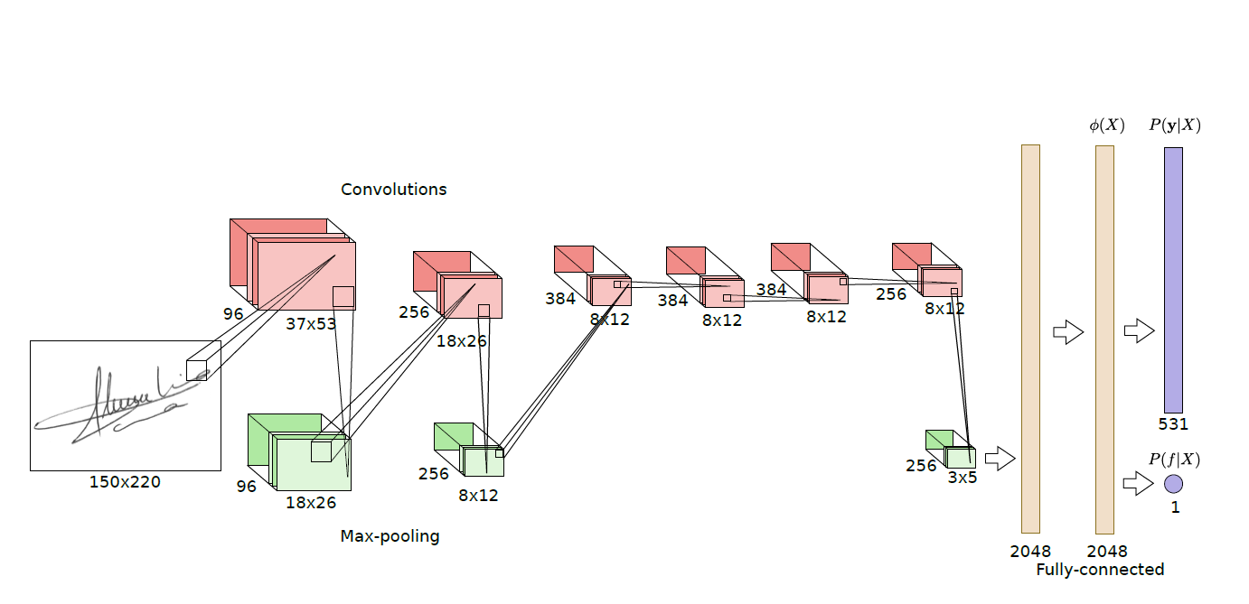
Figure 4. Illustration of the CNN architecture used in original paper.

Slide 10

Multi-task learning framework
Training set composed of tuples (X; y) where X is the signature image, and y is the user.
A neural network with multiple layers, where the objective is to discriminate between the users in the Development set.
The last layer of the neural network has M units with a softmax activation, where M is the number of users in the Development set, and estimates P(y|X).
Cost function in general.
y_{ij} is the true target for example i, X_{i} is the signature image, and P(y_{j}|X_{i}) is the probability assigned to class j for the input X_{i.}
This cost function can then be minimized with a gradient-based method.

Slide 11
Multi-task learning framework
One of the main goals of a signature verification systems is distinguishing skilled forgeries.
Limitation of the General cost function → nothing in the training process to drive the features to be good in distinguishing skilled forgeries.
Adding a separate output for detecting forgeries and considering two terms in the cost function for feature learning they tackle this issue.
First term drives the model to distinguish between different
Second term drives the model to distinguish between genuine signatures and skilled forgeries.
P(f|X), is another output of the model, a single sigmoid unit, that seeks to predict whether the signature is a forgery or not.

Slide 12
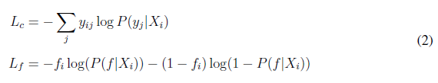
Multi-task learning framework
Training set is tuples of the form (X, y, f)
where X is the signature image
y is the author of the signature (or the target user, if the signature is a forgery)
f is a binary variable that reflects if the sample is a forgery or not (f = 1 indicates a forgery).
Genuine signatures and forgeries targeted to the same user have the same y.
The loss function combines:
user classification loss (L_{c}) is a multi-class cross-entropy,
and the forgery classification (L_{f}) is a binary cross-entropy.

Slide 13
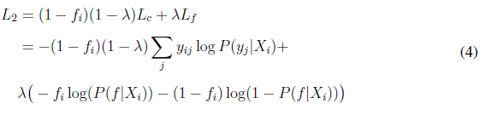
Multi-task learning framework
First term guides the model to learn features to distinguish between different users.
Second term will focus on characteristics that distinguish between genuine signatures and forgeries.

Slide 14
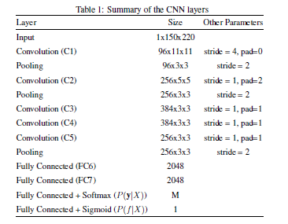
Feature learning systems (1)
The architecture that performed best for the formulation
The CNN consists of multiple layers
Convolutions
Max-pooling
fully-connected layers
Convolutional layers and fully-connected layers have learnable parameters → optimized during training
after each learnable layer they applied Batch Normalization, followed by the ReLU non-linearity.

Slide 15
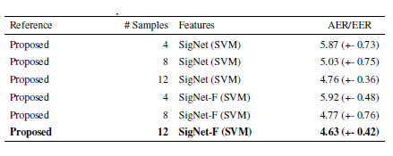
Feature learning systems (2)
Optimization was conducted by minimizing the loss with Stochastic Gradient Descent with:
Nesterov Momentum
Mini-batches of size 32
Momentum factor of 0.9
L2 penalty with weight decay 10e-4, As regularization
60 epochs of training, with an initial learning rate of 10e-3, that was divided by 10 every 20 epochs.
random crops of size 150x220 from the 170x242 signature image.
Table II. SVM classification reported results from paper that is better than state of the art approaches in literature.

Slide 16
Our Implementation
implementing papers method with deep learning architectures like keras and TensorFlow
Feature extraction architecture to extract features
Some modification in their architecture and minimize the number of output features 2 times less than original paper and reach to good result.
In this project, we implement formulations for learning features for Offline Signature Verification from [1]
Evaluate the performance of such features for training Writer-Dependent classifiers.

Slide 17
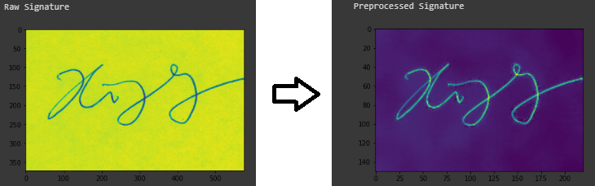
Preprocessing
read all with openCV in python:
images as a grayscale in 2D array format
extract users' name from folder name of image addresses
for all images:
Inverting each image by (image = 255 – image), such that the background is zero-valued.
Resize the image to the input size of the network → (150,220)
Threshold to remove some noises.
Perform cv2.fastNlMeansDenoising function for making signatures without any noises
Convert our Images to 3D format to feed in CNN, we used np.expand_dims() function of NumPy.
At the end we changed all arrays to NumPy array.
Sample image after preprocessing

Slide 18
Dataset to train
CEDAR dataset:
55 user
2640 signature of 55 user
24 genuine and 24 forgery signature for each user
For a multi-output classification network with a single input, we merge the genuine and forgery images together
Separate label vectors for each output:
User label vector → each signature image in one hot encoded format
Res label vector → Result (Genuine=0, forgery=1) in a binary.
Forgery | Genuine | WD set | WI set | Users | Dataset
24 | 24 | 15 | 40 | 55 | CEDAR
Splitting dataset to WD and WI sets

Slide 19
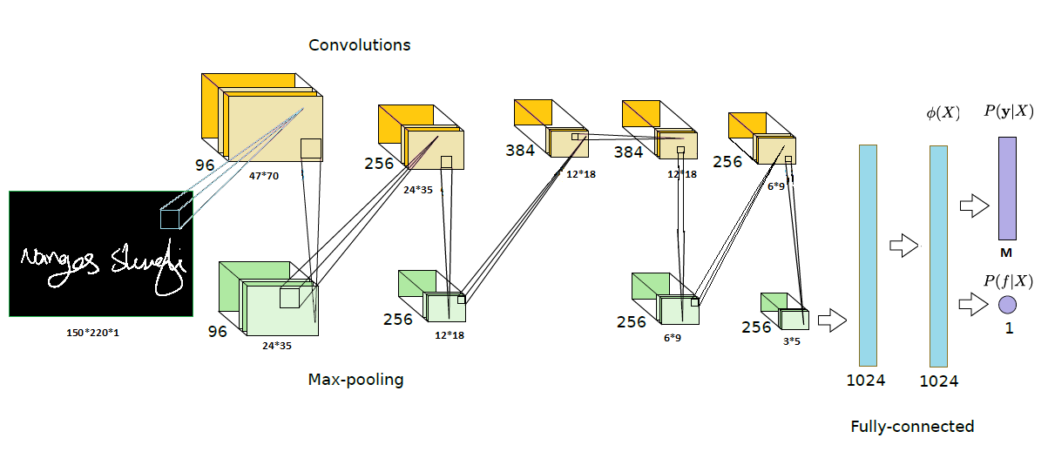
Modified CNN Architecture
Some modifications to minimize the number of output features.
2048 size FC layer in paper.
We added one Max Pooling layer between CL4 and CL5 layers with stride of 2.
We changed FC1 size to 1024.
To have fewer features to learn we changed last FC layer to 1024
Our proposed CNN architecture

Slide 20
Multi-Output CNN Model Implementation
Parameters | Size | Layer
 | 150*220*1 | Input
Stride=3, pad=0 | 11*11*96 | Conv2D (CL1)
Sride=2 | 3*3*96 | MaxPooling
Sride=1, pad=same | 5*5*256 | Conv2D (CL2)
Sride=2 | 3*3*256 | MaxPooling
Sride=1, pad=same | 3*3*384 | Conv2D (CL3)
Sride=1, pad=same | 3*3*384 | Conv2D (CL4)
Sride=2 | 3*3*384 | MaxPooling
Sride=1, pad=same | 3*3*256 | Conv2D (CL5)
Sride=2 | 3*3*256 | MaxPooling
- | 1024 | Fully Connected (FC1)
- | 1024 | Fully Connected (FC2)
- | M | Softmax
- | 1 | Sigmoid
Input image passed to convolutional layer with regularization of 0.01.
After each convolutional layer, batch normalization is applied.
MaxPooling layers used to compress the output features.
DropOut used to Prevent OverFitting
MultiOutput divided to SoftMax and Sigmoid
Summary of CNN layers

Slide 21
Evaluation of keras model
Value | Parameter
True | Nestrov
0.9 | Momentum rate
1e-4 | Weight Decay
64 | Batch-size
1e-5 | Initial Learning rate (LR)
LR ← LR × 0.1 | Learning Rate Schedule
120 | Epochs
Evaluation of model in WI set with 5-Fold
User accuracy is 100%
Res accuracy is 99.21% with threshold of 0.5.
Hyper Parameters
Run time (min) | Accuracy User | Accuracy Gen/Forg | Dataset
11 | 98.21 | 100 | CEDAR
Results with stratifiedkfold 5-FOLD

Slide 22
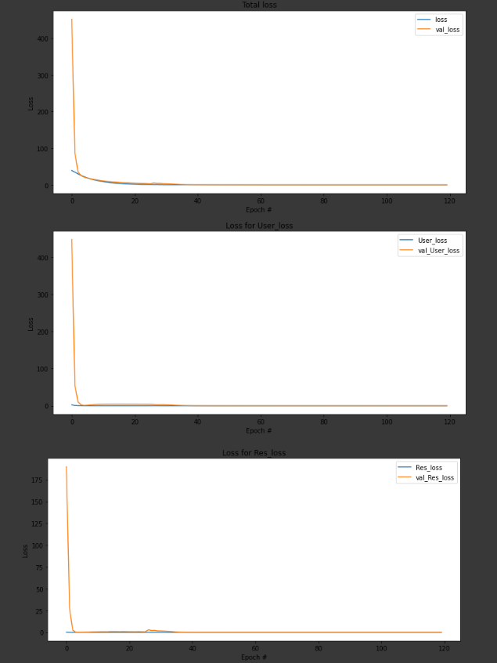
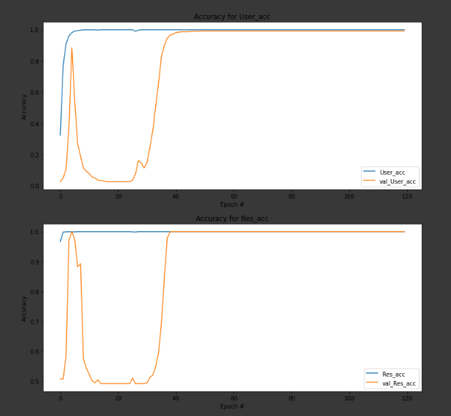
Accuracy in all epochs for User Accuracy and Res Accuracy for both train and validation set
Loss in all epochs for total loss, User loss and Res loss for both train and validation set

Slide 23
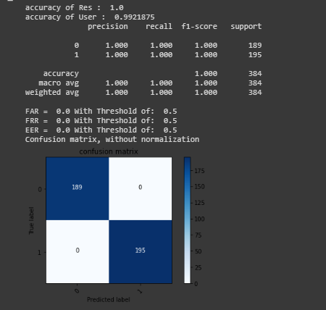
Test and Evaluations
For Res we define a threshold list
[0, 0.1, …,1]
We predict Res for each threshold
Calculate FRR, FAR, accuracy of user and Res
Confusion matrix plotted to have a general view of system to pick the best threshold.
Results plot on test set, accuracies, FAR and FRR based on thresholds

Slide 24
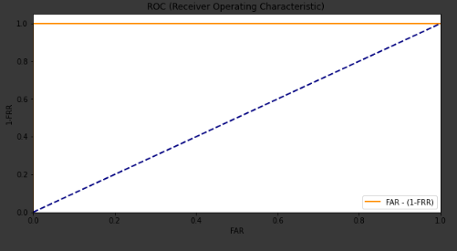
ROC curve
graphical plot that illustrates the diagnostic ability of a binary classifier system as its discrimination threshold is varied.
The ROC curve is created by plotting the TPR against the FPR at various threshold settings. Wikipedia
In plot we can see that as TPR (1-FRR) increase the FAR increase.
ROC curve code and plot

Slide 25
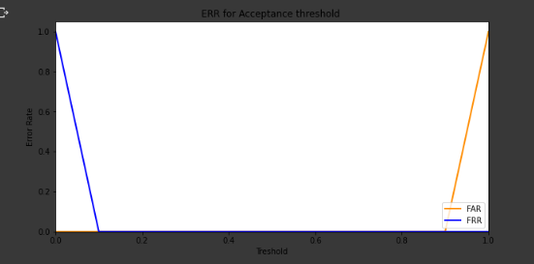
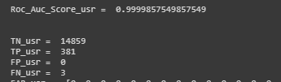
Results from Keras Callback history
For user we write a code to extract all FA and FR’s for all users
We sum all of user’s to see the number of mistakes of our system out of 192 signatures for test
0 Genuine Rejected users, 0 False Accepted Imposters
We assume all other users' images as imposter for specific user
Plot for EER finding
Results for User output

Slide 26
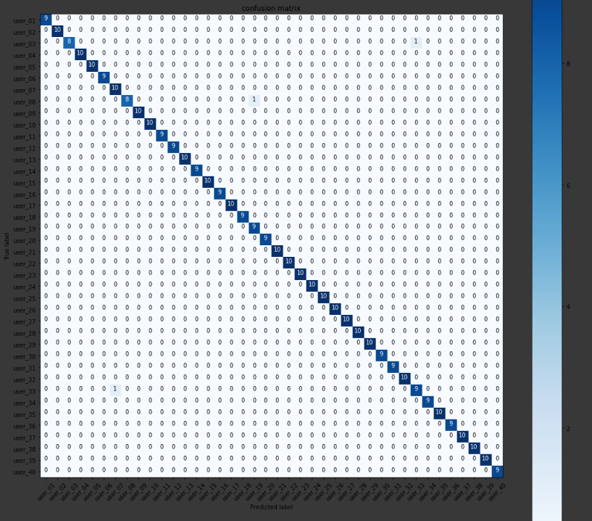
confusion matrix plot for users

Slide 27
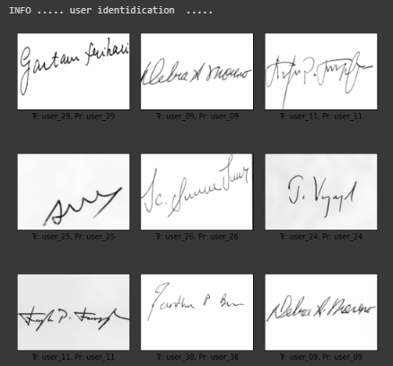
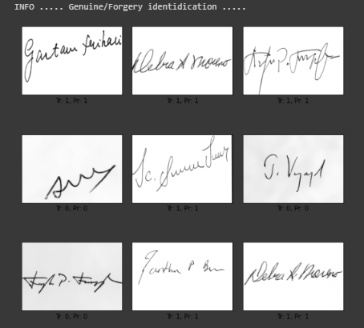
Our systems Predictions
Some of our predictions and their ground truth for user Identification
Some of our predictions and their ground truth for Genuine/Forgery Detection

Slide 28
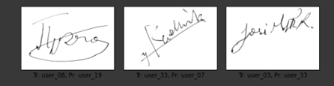
Our systems Mistakes
Misclassified Users

Slide 29
Simulating Biometric System Authentication
Getting new persons signature
Performing preprocessing
Prediction based on Trained model
Performing Authentication mechanism
Give access in case the probe passes our test.
Authentication mechanism

Slide 30
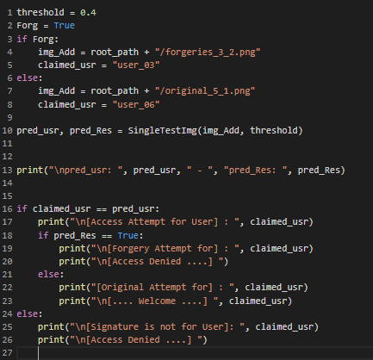
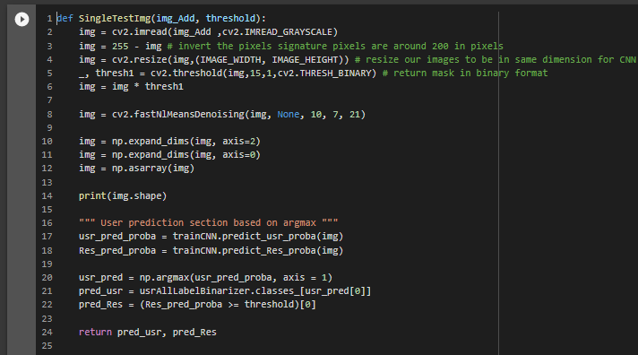
Function to get prediction after giving threshold and Raw Signature
Authentication Process

Slide 31
Writer-Dependent (WD)
Using last FC layer output as features of signatures.
train Writer-Dependent classifiers on a disjoint set of users used to train CNN model
training different SVM classifiers for each user
RBF kernel SVM classifier with C=1000 as WD classifier
half of Genuine and Forgery Signatures of each user to
oversampling of train data by three times
EER | FRR | FAR | Test samples | Train samples | Dataset
0% | 0% | 0% | 36*24=720 | 15*24=360 | CEDAR
Mean Results by Running stratifiedkfold with 5-fold

Slide 32
References
Learning features for offline handwritten signature verification using deep convolutional neural networks https://arxiv.org/pdf/1705.05787.pdf
Pal S., Pal U., Blumenstein M. (2014) Signature-Based Biometric Authentication. In: Muda A., Choo YH., Abraham A., N. Srihari S. (eds) Computational Intelligence in Digital Forensics: Forensic Investigation and Applications. Studies in Computational Intelligence, vol 555. Springer, Cham
Hameed, Shaimaa & Ridha, Arwas. (2019). DIGITAL SIGNATURE METHODS BASED BIOMETRICS. International Journal of Advanced Research. 7. 2320-5407.
Yang, Wencheng & Wang, Song & Hu, Jiankun & Guanglou, Zheng & Chaudhry, Junaid & Adi, Erwin & Valli, Craig. (2018). Securing Mobile Healthcare Data: A Smart Card based Cancelable Finger-vein Bio-Cryptosystem. IEEE Access. PP. 1-1. 10.1109/ACCESS.2018.2844182.
Code for plotting confusion matrix. https://scikit-learn.org/stable/auto_examples/model_selection/plot_confusion_matrix.html
Keras Documentation https://keras.io
Scikit-learn documentation https://scikit-learn.org
Numpy Documentation http://www.numpy.org/
Matplotlib Documentation https://matplotlib.org/
Convolutional Neural Network Explanation https://towardsdatascience.com/a-comprehensive-guide-to-convolutional-neural-networks-the-eli5-way-3bd2b1164a53
datasets from https://cedar.buffalo.edu/NIJ/data/

Slide 33

Thank you

Slide 34

questions

